Slide 1
Lecture 5 Boolean Retrieval Model
Term and Incident Matrix
03February 2023

Slide 2
Boolean Data Matrix Example
Consider below sentences, 1. I am a cow. 2. Cow is what I am. 3. Today is Tuesday.
Now, if I ask you a question — Can you tell the sentences which contain the term ‘cow’ but not ‘Tuesday’? As a human, it is easy for us to say that the answer will be sentence 1 and sentence 2. But how to model this problem mathematically so that it can be solved by a machine?

Slide 3
Term-Document Incidence Matrix
The term-document incidence matrix is one of the basic techniques to represent text data where, > We get the unique words across all the documents. > For each document, we add 1 if the term exists in the document otherwise fill 0 in the cell.

Slide 4
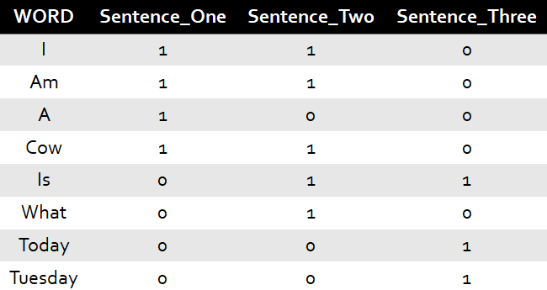
Conversion of Term-Document to Incidence Matrix
1. I am a cow. 2. Cow is what I am. 3. Today is Tuesday.
Term-Document Incidence Matrix for the sentences — 1, 2 and 3.
Note : Words are normalized i.e. same word is not considered twice across all the documents/sentences.

Slide 5
Boolean Retrieval Model
It is one of the application of this matrix where we can answer any query which is in the form of a Boolean expression of terms, that is, in which terms are combined with the operators and, or, and not.

Slide 6
Relate with Example
For our query i.e. get the sentences which contain the term ‘cow’ but not ‘tuesday’, > We will get the term vector, which is basically, the values from the row containing the term in Term-Document Matrix. Example — For Cow, the vector will be [1,1,0].

Slide 7
Process to Make Model
Perform a Bitwise AND operation between the vectors of the terms provided in the input query.
Let’s apply the algorithm and see if we get the right answer.
Cow Vector = [1,1,0]
Tuesday Vector = [0,0,1].
Not Tuesday Vector = [1,1,0].
Not vector can be obtained by taking compliment of the original vector.

Slide 8
Perform BITWISE AND OPERATION on Cow Vector and Tuesday Vector
[1,1,0] & [1,1,0] => [1,1,0]

Slide 9
Inference from the result
In the result obtained from BITWISE AND operation, the indices for which 1 is present, those sentence satisfy the input query. Hence, sentence one and two contain the word ‘cow’ but not ‘tuesday’ and will be returned as result for the query.

Slide 10
Conclusion
Term-Document Incidence matrix is one of the basic mathematical model to represent texts and it can be used to answer Boolean expression queries via model called Boolean Retrieval Model. Below are the key points to consider:
It can answer any query which is a Boolean expression.
Views document as the set of terms.
Good precision since the documents are retrieved only if the condition is matched.

